Slide 1
Current Setup
Wash
Waste
Control PC
Wash
Waste
Potentiostat
1
3
2
4
Anode
Pumps
Temp
Control
Cathode
Pumps
Anode Samples
Anolyte
Chamber
Catholyte
Chamber
Cathode Samples

Slide 2
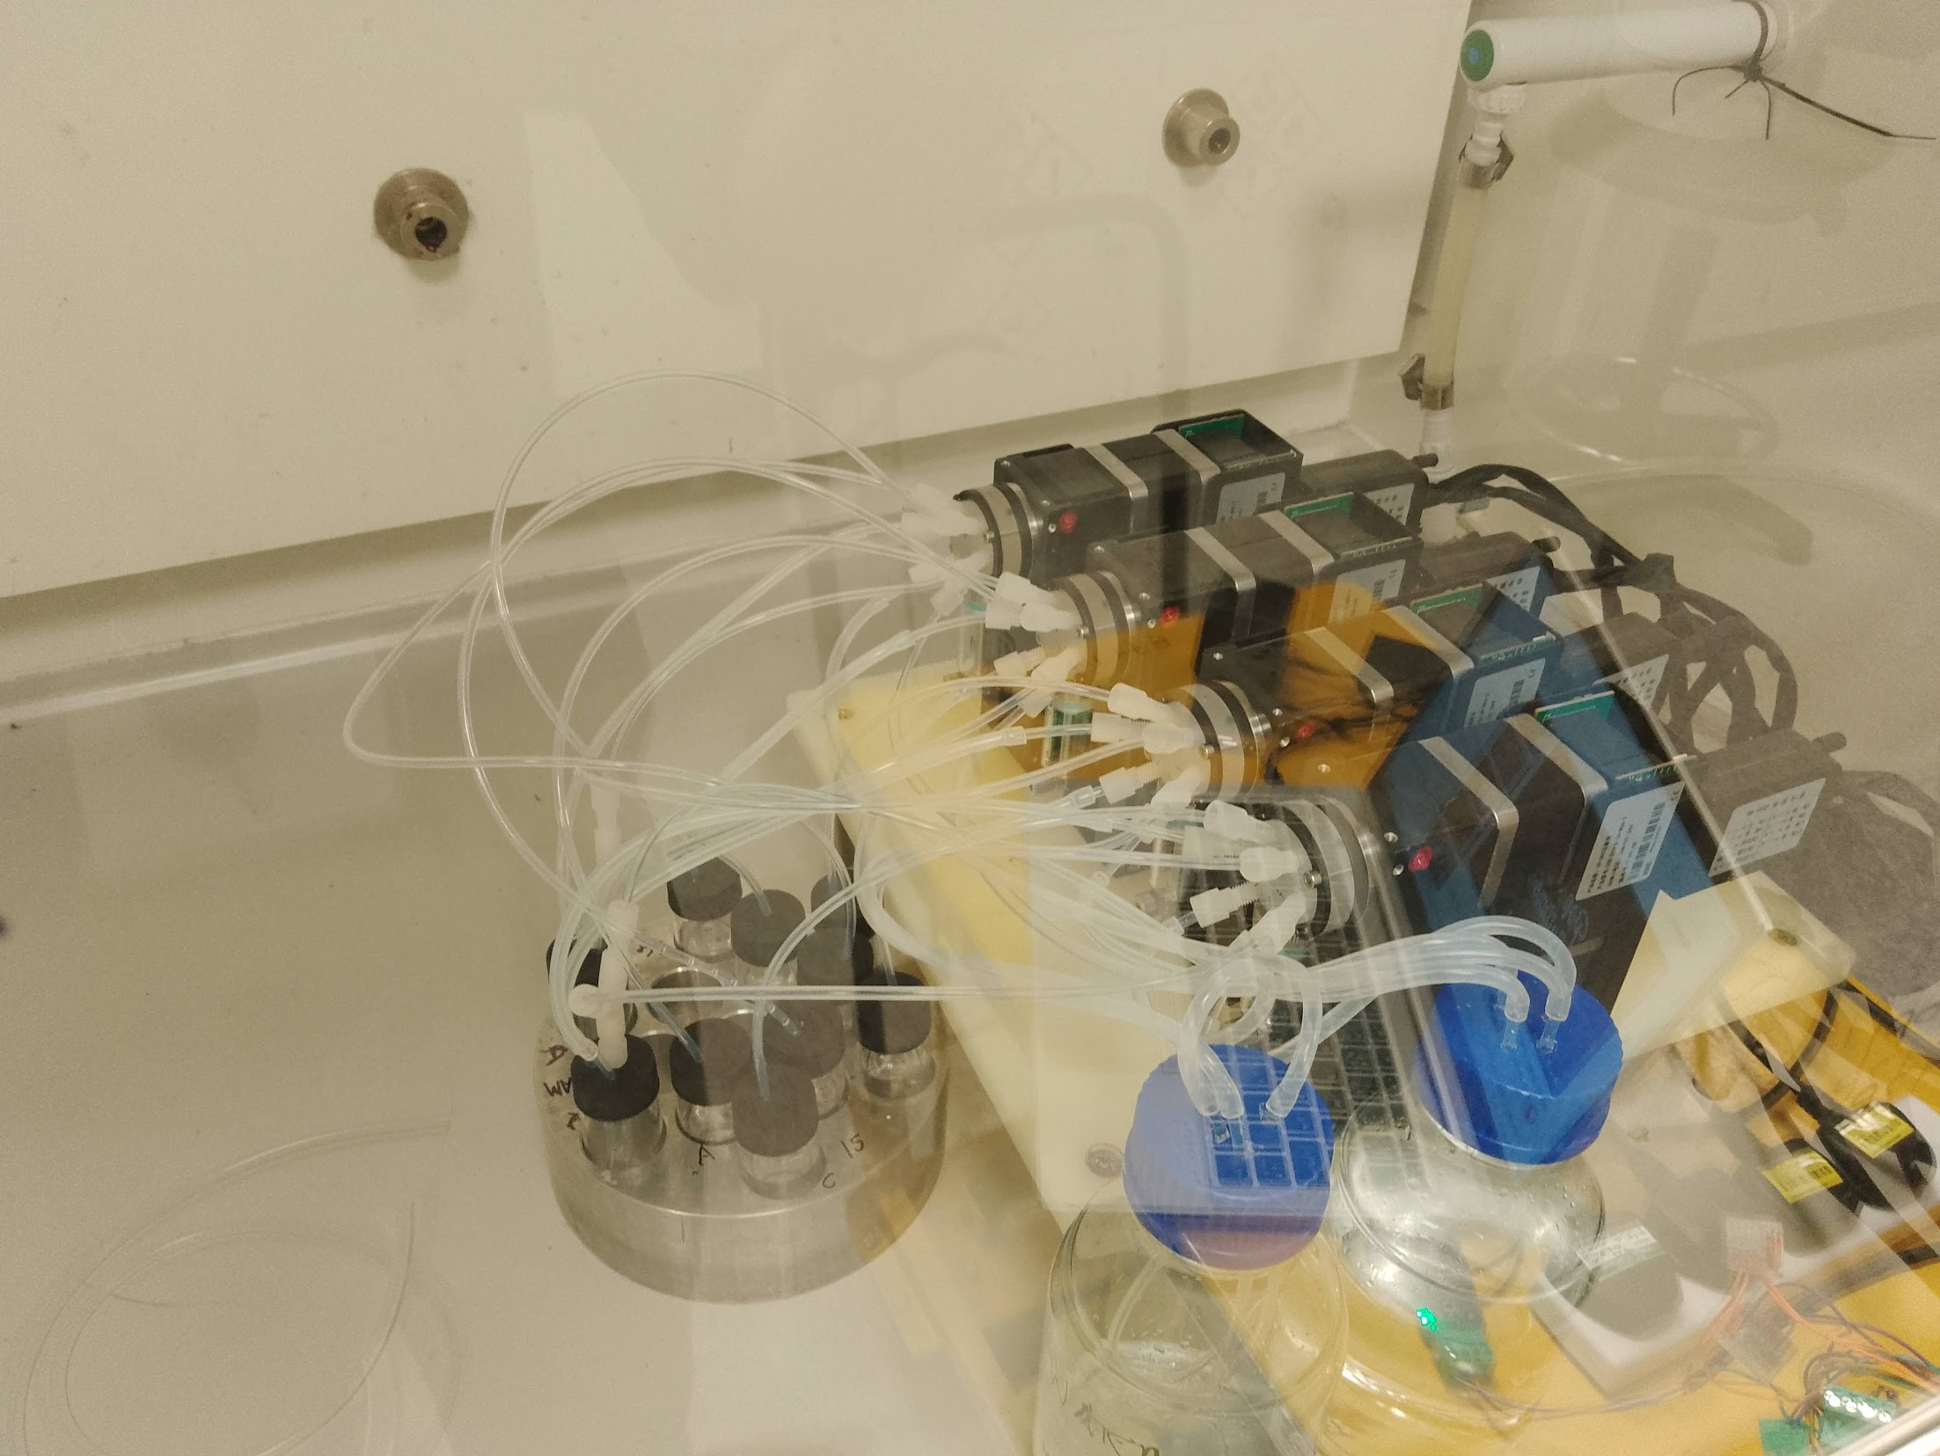
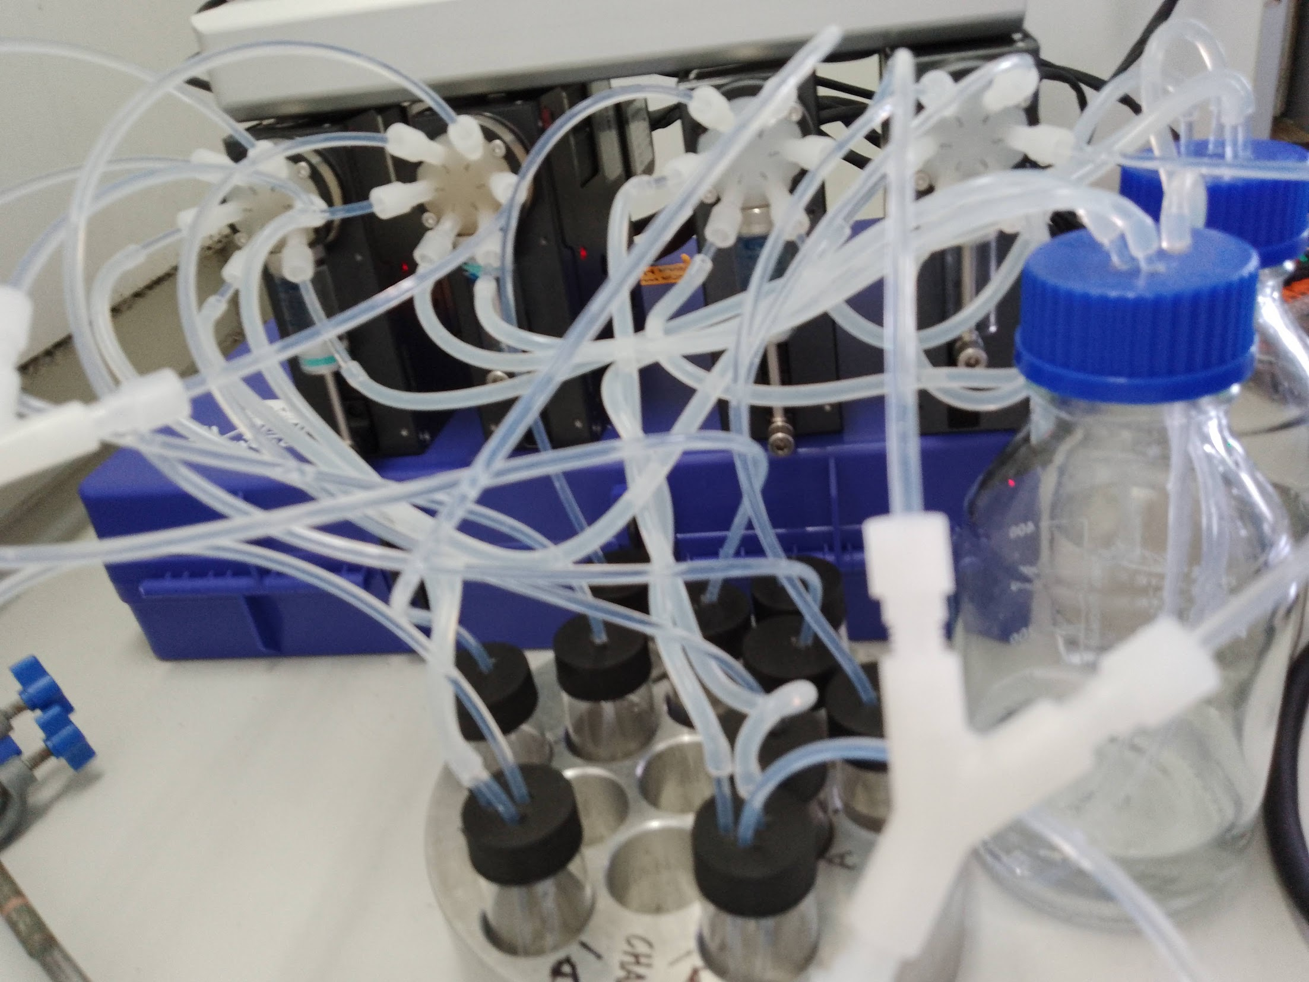
Current Spec
Addressable samples for each run
  E.g. [1,2] means 1st sample on anode and 2nd sample on cathode
  Returns samples to original pot after testing (15ml)
System runs on ivium potentiostat
  Runs off saved methods from ivsoft
Cleaning functions integrated at the end of every run
  Membrane
  Chamber
  Syringes
Manual temperature control – all experiments in one batch (4 pairs) must be run at one temp
Currently based in Chem831 for prototyping & testing

